Slide 1

Applications of Human Activity Recognition (HAR) and Machine Learning (ML) in biomedical engineer
March 20, 2021

Slide 2
Table of contents
Presentation
Overview of HAR and BME
Theory of ML
Application of HAR using ML in BME
Example
Python application of SVM for HAR

Slide 3
Objective
Python Example of Random Forest (RF) for HAR dataset
Meant for beginners to intermediate users
Python knowledge will be needed for the example but can be studied on your own time

Slide 4
Schedule
20-25 minutes for Presentation
30 minutes for Python
5 minutes for questions

Slide 5
Suggestions
Follow the presentation (write notes and understand the topic)
Practice in your own time
Ask questions in the chat

Slide 6
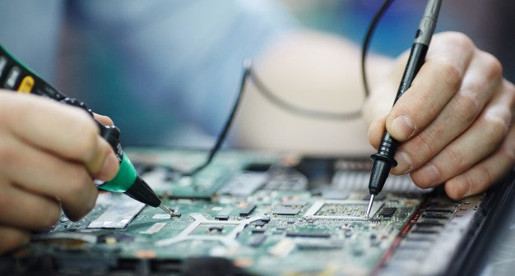

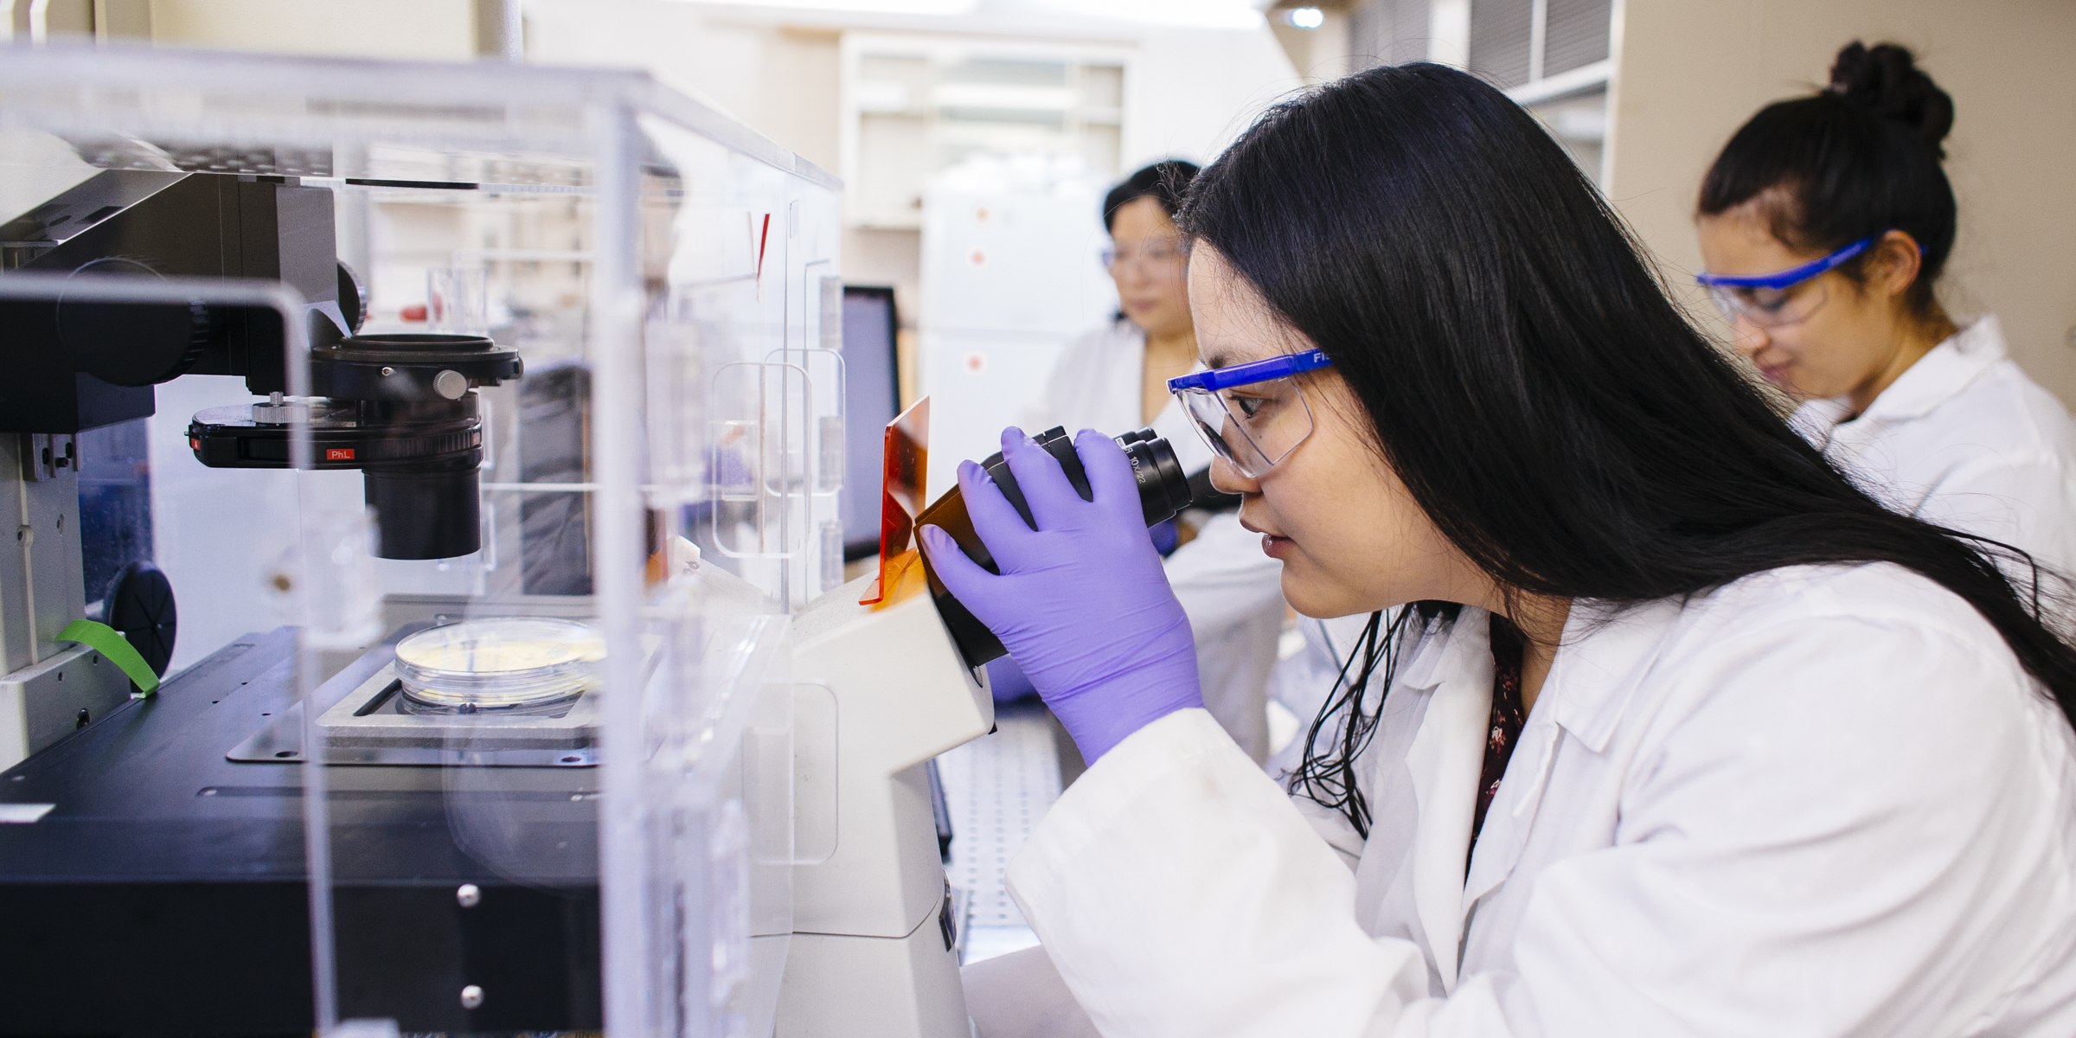
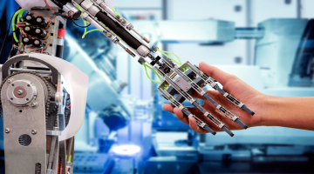
Biomedical engineer
Notes:
Mendi?

Slide 7

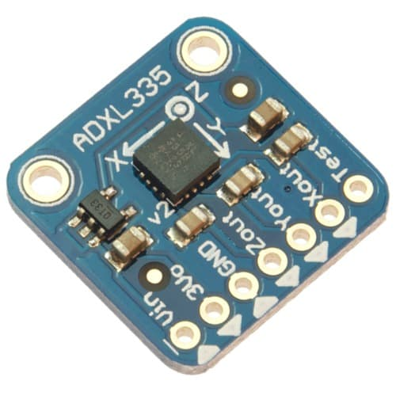
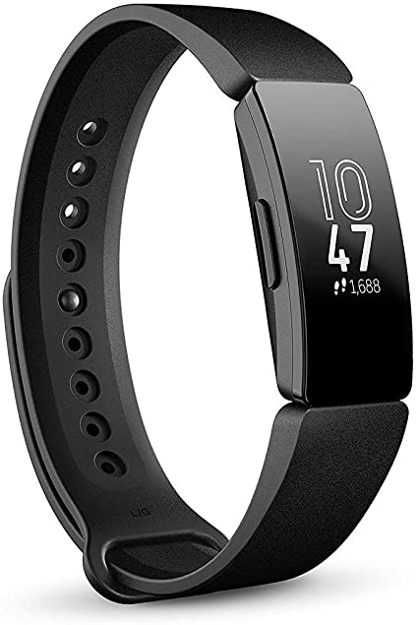
Human Activity Recognition (HAR)
The use of wearable technology to monitor an individual’s daily activities
Notes:
HAR… define it
let’s see some examples
We have iphone… acceleromter
They’re all really different devices but one thing they have in common is that they all collect data

Slide 8
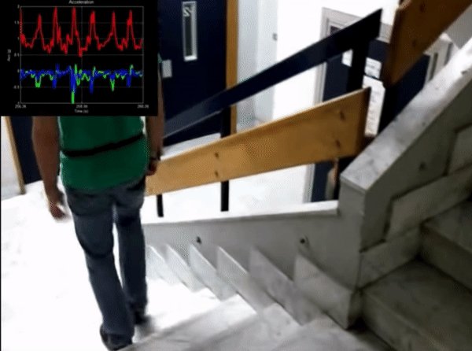
HAR in Engineering applications
Pre-processing
Machine learning
Big data applications
Data science
Passive Data

Slide 9
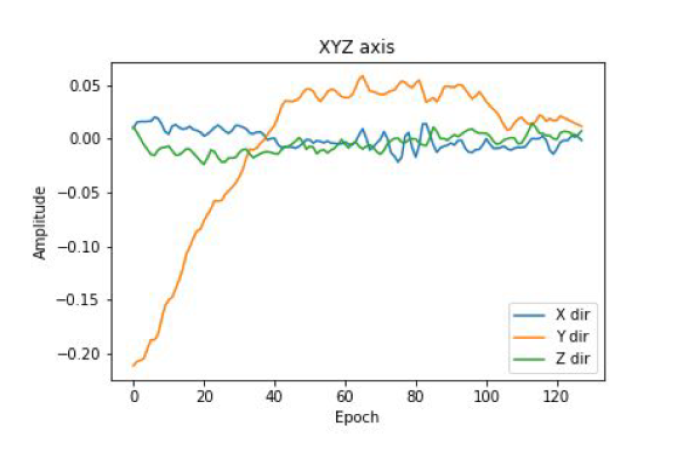
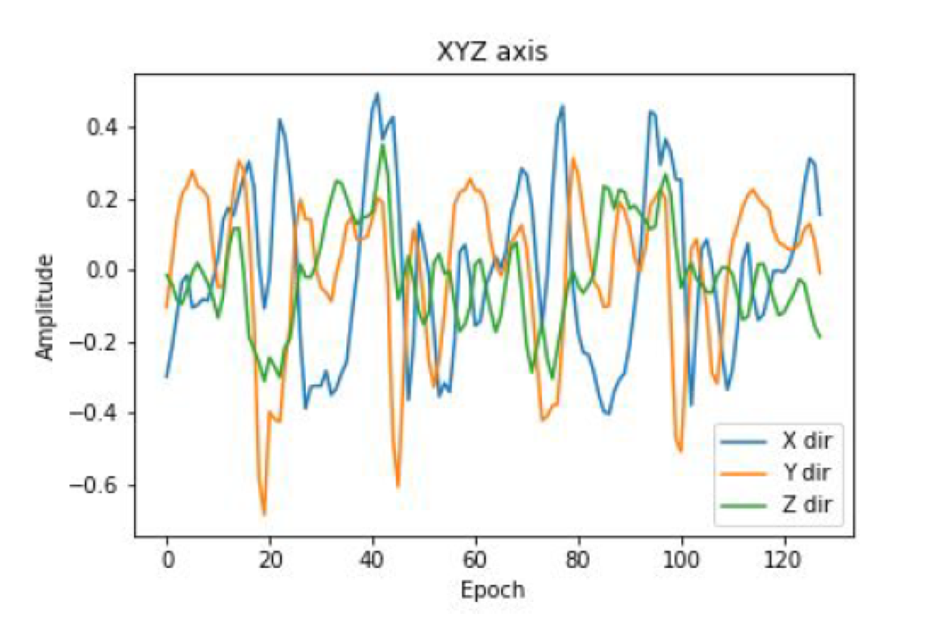
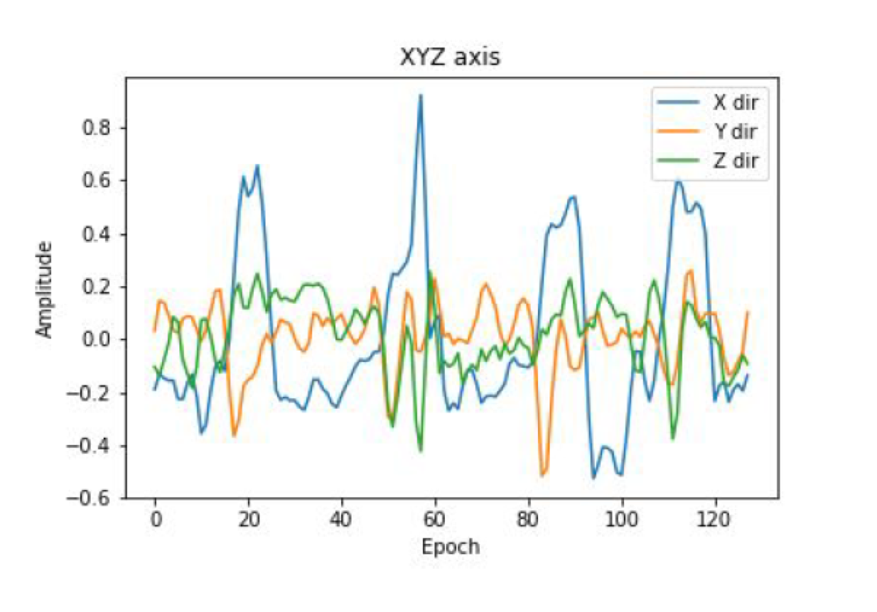
Passive data
Passive sensor is a device that detects and responds to some type of input from the physical environment.
Passively collect data
E.g GPS, accelerometer
Notes:
What is it?

Slide 10
How do you determine what activity a user is doing?

Slide 11
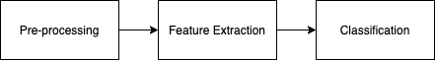
Machine Learning

Slide 12
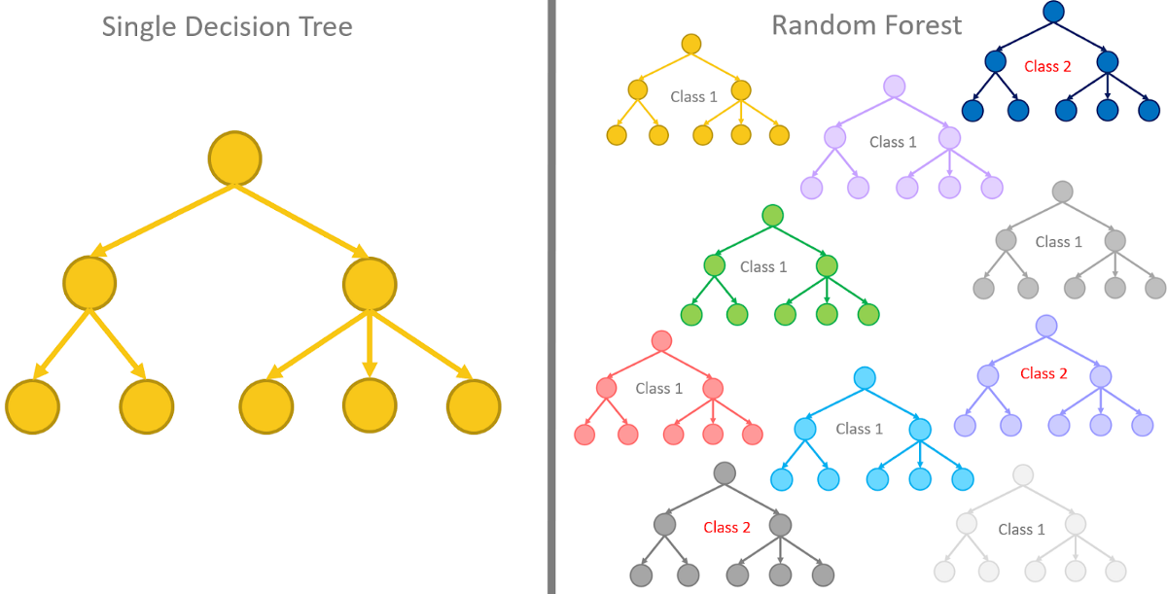
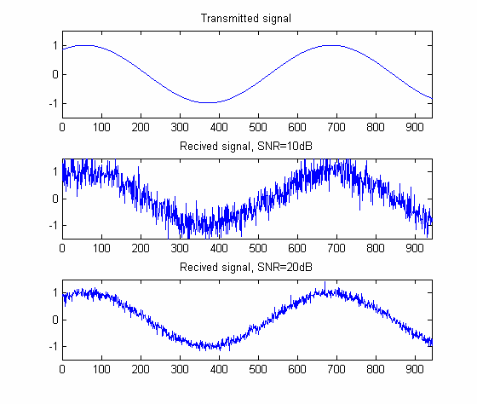
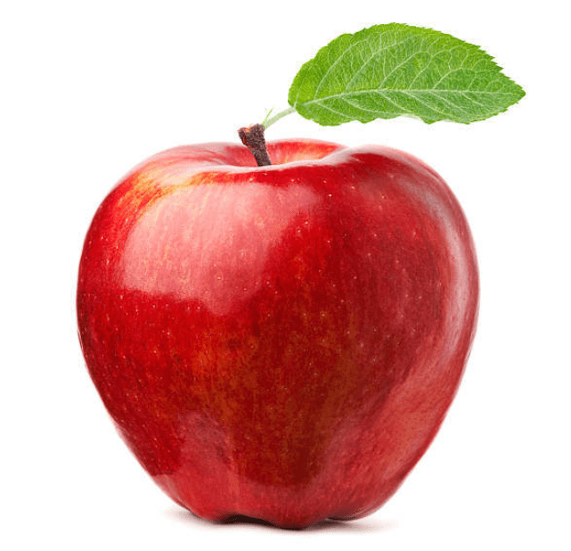
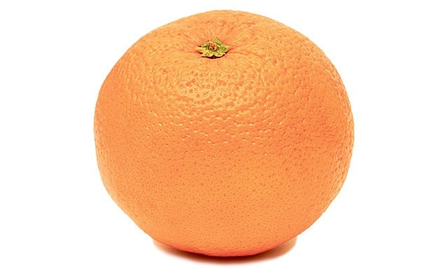
Signal processing, Feature extraction, ML
B. Nguyen, Y. Cohelo, T. Bastos, Krishnan S.. Trends in Human Activity Recognition
with focus on Machine Learning and Power Requirements Special
Issue ”Machine learning and Applications”, submitted, July 2020.
Notes:
How to analyze it

Slide 14
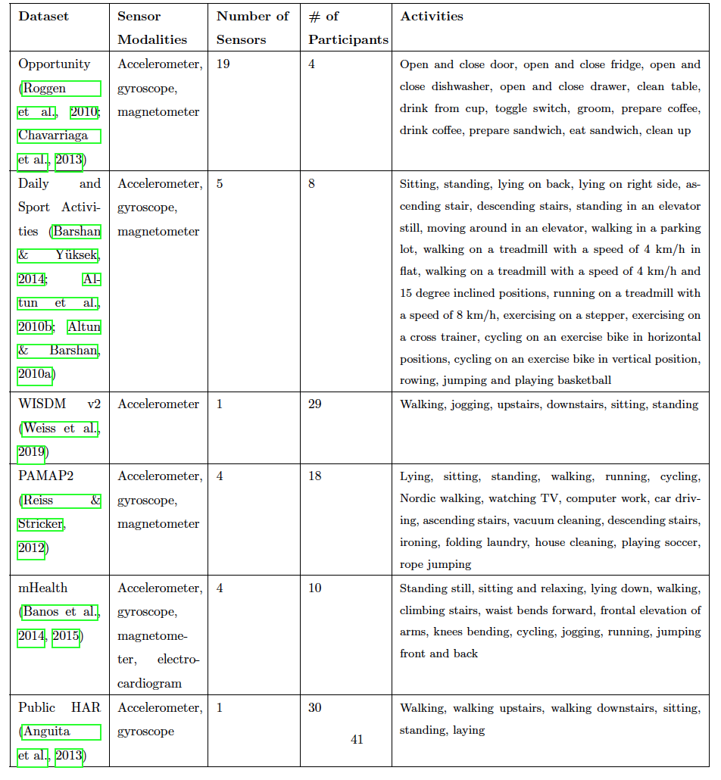
HAR Datasets
B. Nguyen, Y. Cohelo, T. Bastos, Krishnan S.. Trends in Human Activity Recognition
with focus on Machine Learning and Power Requirements Special
Issue ”Machine learning and Applications”, submitted, July 2020.
Notes:
Where to get your hands on this

Slide 16
What are some examples of ML and HAR applications in BME?

Slide 17
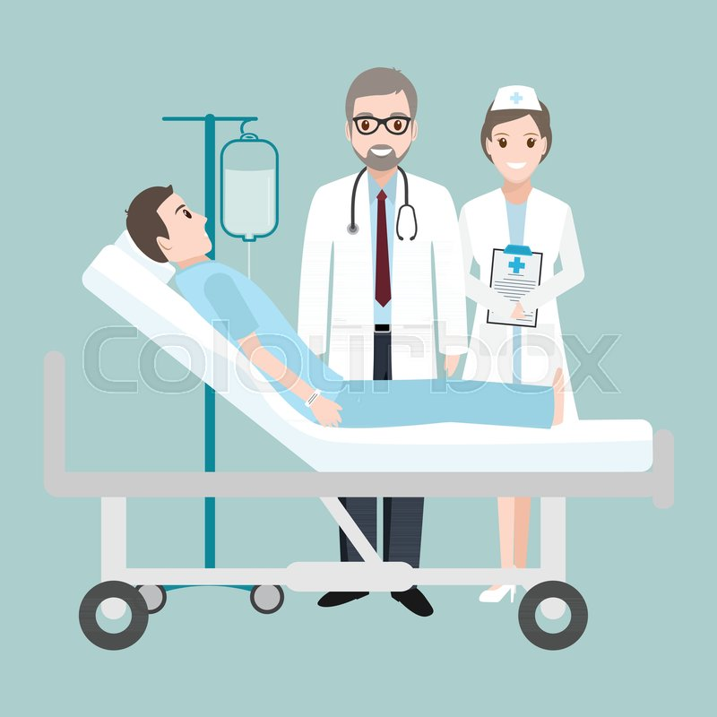

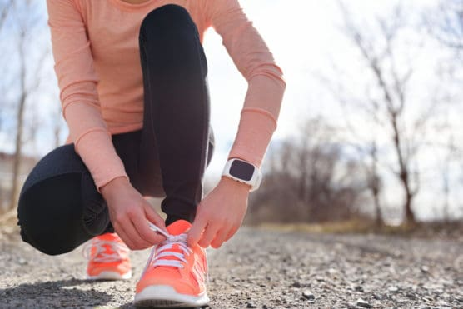

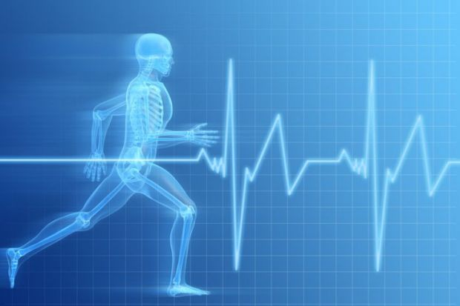
HAR in BME
HAR can be used as a monitoring system
Sports
Medicine
Consumer health monitoring
COVID-19
Mental health

Slide 18
Python

Slide 19
Numpy
Mathematical library in Python
Statistical anaylsis

Slide 20
Examples
import numpy as np
Np.sum(x)
Np.mean(x)

Slide 21
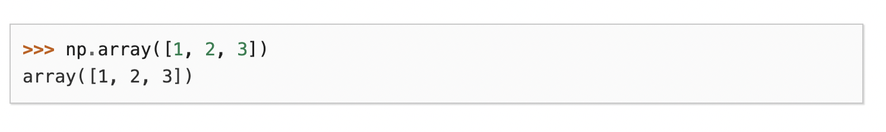
arrays
An array is a container object that holds a fixed number of values of a single type. The length of an array is established when the array is created. After creation, its length is fixed.

Slide 22
Pandas
Dataframe simply represents a table of data with rows and columns. The list of columns and the types in those columns the schema
A simple analogy would be a spreadsheet with named columns
Imports datasets

Slide 23
Examples
Import panda as pd
pd.csv_read()

Slide 24
Sci kit learn
Machine learning library

Slide 25
Summary
Numpy
Statistical analysis
Mathematical operations
Arrays
Panda
Importing datasets
Sci kit learn
Machine learning

Slide 26
Expected outcomes
The goal is to use features to create a model and predict other data and give an accuracy based off the test label
Steps
Pre-process
Feature set
Train your model
Test your model
Accuracy

Slide 27
Pre-processing
Skip

Slide 28
Feature set
Extract features from your data
Create a feature matrix:
Features as columns
Sample as rows

Slide 29
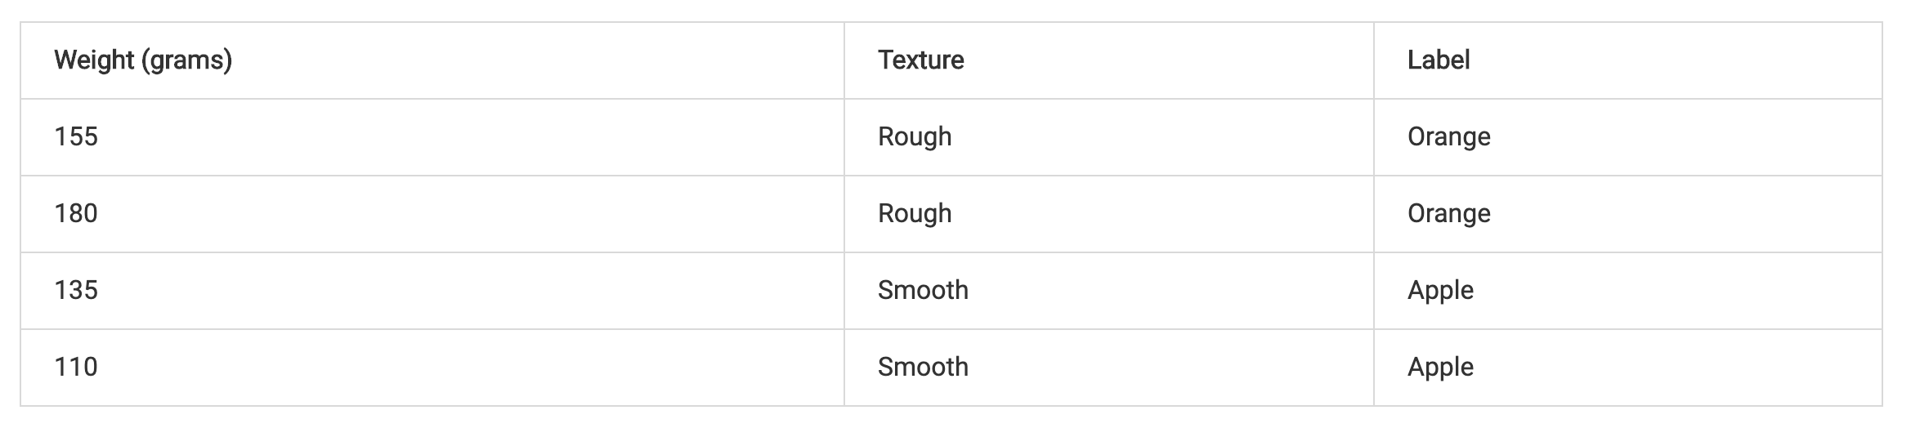
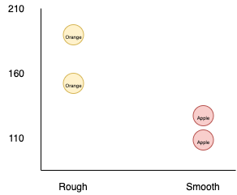
ML Example
Feature 1
Feature 2
Label

Slide 30
Python
Open folder and explain the dataset
Dataset is of HAR
30 subjects
Activities include stationary, walking, walking upstairs, downstairs, sitting and lying down
Data collected using accelerometer, gyroscope and magnometer
Used windowing, which has 128 samples every window for 2.56 seconds
Dataset is 7352x128

Slide 31
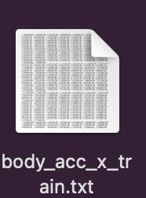
Data

Slide 32
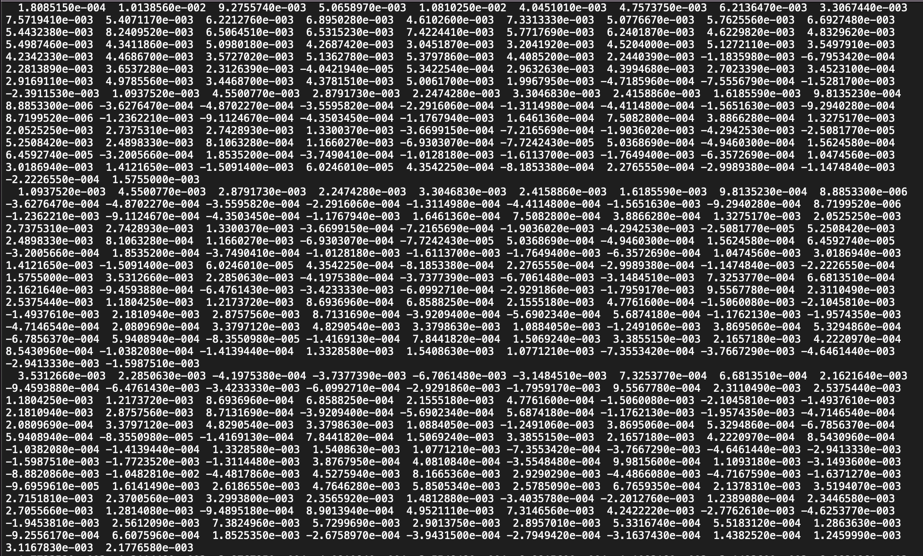

Slide 33
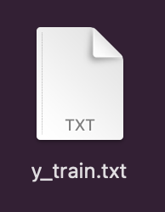
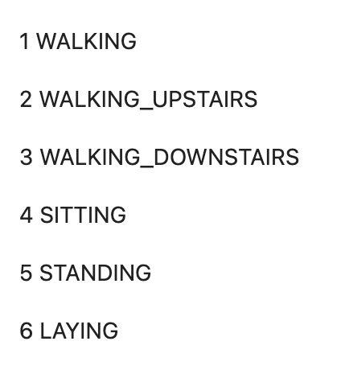
Labels

Slide 34
Feature Matrix
Sample | Average | Labels
1 | 0.002269 | 3 (Walking downstairs)
2 | 0.000174 | 3 (Walking downstairs)
3 | 0.000428 | 4 (Sitting)

